Slide 1
Advance Internship@Clevered AI App/ Project Name
App User Manual
Author: Sai Kaushik Choppara

Slide 2
Table of Contents
Graphical User Interface
Start button
Quit button
Motion Detection logo
Camera motion detection
Alarm

Slide 3
Acknowledgements
A small vote of thanks for all who have helped me in this journey of App Development – my parents, Mr Ken, Clevered, Mentors, Group Members, Friends, Sites etc.

Slide 4
About Me..
Student’s Photograph
I have done all my academics in the UAE. I currently study 12th grade and am interested in sports such as cricket, badminton and biking. My interests outside sports are automobiles and computer science. My plan is to do my university in the USA and take up computer science as my major.

Slide 5
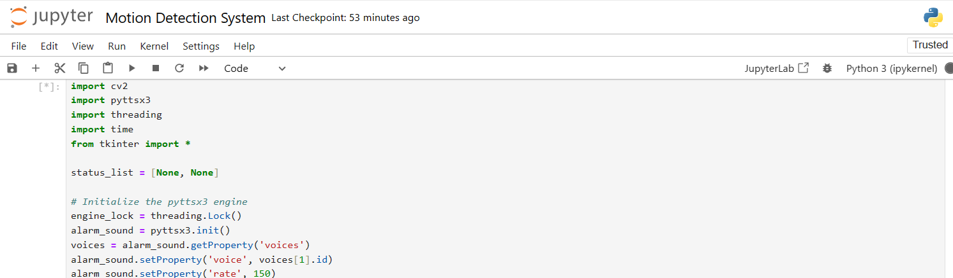
About My Internship with Clevered..
Any photographs from sessions etc.
During this internship I have learnt new skill sets and created my first motion detected application. Clevered and Miss Pratibha have guided me to embark on a new experience that I get to boast about.

Slide 6
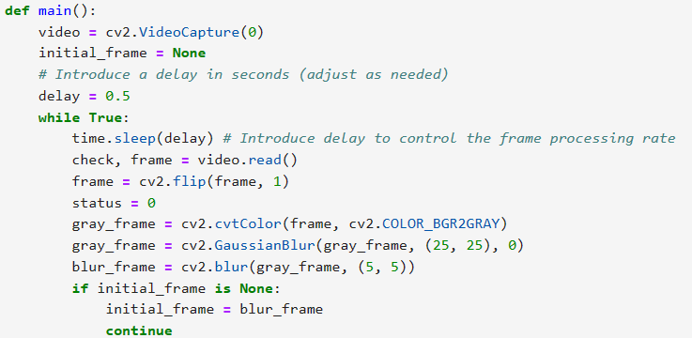
About App..
App’s Main Menu
App’s screenshot
App’s Introduction
The GUI or main menu consists of the label “motion detector” and consists of a text box that says, “click q to quit”. There is also a start button which when clicked, turns on the camera and detects the motion and alerts if the object is still or moving.

Slide 7
How do I use the App?

Slide 8
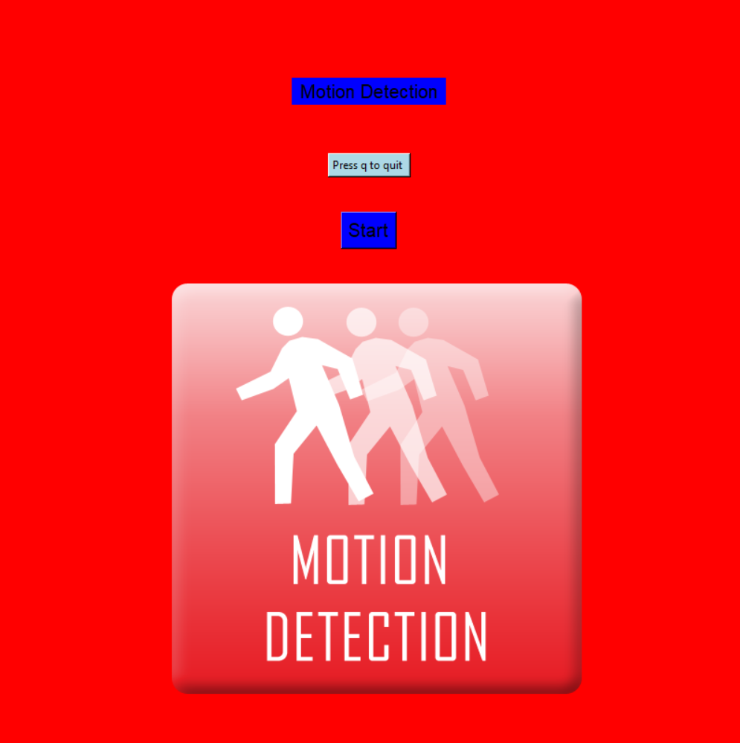
Option Name
(This will be repeated for each option of the App)
Screenshot/ Pic of each option/screen of the App.
Steps to use the same
To start the camera, click on the “Start” button. The camera detects the motion and alerts if the person or object is moving or still. To exit or quit the camera, you press the ‘q’ button.
Any special considerations/ dependencies/risks while using the option

Slide 9
Contact Person
Please reach out to student name at student’s email address for any questions/ concerns/ suggestions on the App
Email: kaushik.sai1112@gmail.com

Slide 10
Thank you!

